Slide 1
Career Development Resources

Slide 2

Name (alias), Title
About leader | Core strengths | Development areas & actions
Career goal: what is your aspiration Potential Next Role: ok to list more than one Time to move: what FY and Qtr are you aiming for your next role, per discussion with your manager Willingness To Relocate: Yes or No Ok to note a time for when you are able to relocate, if that’s the case; e.g. Yes but only after FY26 Relocation Options: Where specifically; e.g., specific cities in US? Specific countries? Language(s): Recent Impact: list a few bullet points from within the past 6 months to year Xxx Xxx Xxx Education: List school and degree Xxx, xxx | Core Strengths: Consider executive attributes, leadership principles and experiences, Microsoft Cultural leadership, outcomes from assessments you may have recently completed, feedback from manager or mentor(s), partner success indicators, profile for current role or potential next role Xxx Xxx Xxx Xxx | Areas of development: Consider same items as under Core Strengths Xxx Xxx Xxx Development actions to take over next 12 months: List specific actions that you will take and when for each area of development noted above - prioritize! Follow the 70/20/10 rule to determine actions that may be on-the-job development experiences, social networking like peers and mentors, and formal learning programs. Xxx Xxx Xxx Xxx
Level: xx
History
Past 10 years
xxxx - Present | Microsoft
Title, Dept
xxxx - xxxx | Company name
Title, Dept
xxxx - xxxx | Company name
Title, Dept
xxxx - xxxx | Company name
Title, Dept
xxxx - xxxx | Company name
Title, Dept
xxxx - xxxx | Company name
Title, Dept
Progress/actions since last review (Last 6 months)
Add a couple bullet points to show progress to date
2

Slide 3
Minnie Mouse (Minmo) – Chief Fun Officer
EXAMPLE ONLY
Note all fields have data
About leader | Core strengths | Development areas & actions
Career goal: Country Manager Potential Next Role: OU Leader Time to move: FY25 Willingness To Relocate: Yes, after FY26 Relocation Options: Anywhere US; UK or Germany, Australia Language(s): English, some German and French Recent Impact: Overperformed in first year in role, 26% growth YoY Launched new ERG Learning Cohort with 55% Sr Leaders engaged as mentors and 250 participants Built a resilient leadership team who can execute in the face of changing leadership Microsoft Leader of the Year, 2013 Microsoft Gold Club, 2014 Education (school and degree): Minnesota State University Moorhead, BA Business Admin Minnesota State University Moorhead, Masters Org Leadership | Core Strengths Executive Maturity: Mature sales leader with situational self-awareness. Sales Leadership: Diverse sales leadership from multiple tours of duty at Microsoft. Leads with customer top of mind always. Ability to orchestrate, mobilize and influence execution. People Leadership: Inspirational and empathetic leader who fosters resiliency and loyalty in teams to help them deal with change. Excellent coach. | Development areas Leading at Scale Transformational Leadership Development actions: Leading at Scale: Nurture a true OneMicrosoft culture and accelerate scaling through partners Transformational Leadership: Set leadership and market growth agenda, ensure a shared understanding, excel as leader of leaders, refine strategic decision making, tenaciously pursue the right outcomes.
Level: xx
History
Prior 10 years
Year - Year | Company
Title, Dept
Year - Year | Company
Title, Dept
Year - Year | Company
Title, Dept
Year - Year | Company
Title, Dept
Year - Year | Company
Title, Dept
Year - Year | Company
Title, Dept
Progress/actions since last review (Last 6 months)
Completing 18-month Leadership Program. Building relationships with A14 Leaders, Regional AVPs and WCB leadership. Engaged in mentor relationship with Donald Duck and reverse mentoring with accelerating, EIC diverse talent. Continuing with an executive coach with focus on transformational leadership at scale.
3

Slide 4
Microsoft’s Leadership Principles & Cultural Attributes
Leadership Principle | Definition
Create Clarity | Synthesize the complex Ensure shared understanding Define a course of action
Generate Energy | Inspire optimism, creativity and growth Create an environment in which everyone does their best work Build organizations that are stronger tomorrow than today
Deliver Success | Drive innovation that people love Be boundary-less in seeking solutions Tenaciously pursue the right outcomes
Cultural Attribute | Definition
Customer Obsessed | Approach customers with empathy Advocate for customer Drive customer success
Diverse & Inclusive | Practice awareness Exercise curiosity Demonstrate courage
One Microsoft | Optimize for Team Microsoft Build on and contribute to success of others Look for common ground

Slide 5
Organizational Leadership Capability Areas
Leadership Principle | Definition
Innovation | Deliver clear shared visions and coherent strategies with an outside-in focus and a sense of purpose Exercise strategic foresight Imagine alternative futures Balance short- and long-term planning and business needs
Leading at Scale | Practice and model an owner’s mindset Unlock the potential and thrive in matrixed organizational structure Build structures and processes that minimize need for dependence on or decisions by leader Identify need and facilitate pivots Demonstrate flexibility and ability to quickly made and break plans Demonstrate complex decision-making – knowing what to solve verses not solve
Delivering at Pace | Drive innovation that people love Be boundary-less in seeking solutions Tenaciously pursue the right outcomes
Working Globally & Inclusively | Practice courage, compassion, humility, inquiry and appreciation Build environments of trust and inclusion Unlock potential and thrive in matrixed organizational structure
Building Trust & Collaboration | Build environments of trust and inclusion including structures and processes that minimize need for dependence on or decisions by leader Empower teams through distributed leadership Practice courage, compassion, humility, inquiry and appreciation
Business Growth | Define customer success metrics and use metrics for decision-making Practice and model an owner’s mindset Unlock potential and thrive in matrixed organizational structure

Slide 6
Accountabilities & Actions: Development Solutions (70:20:10)
Purpose
Possible Learning Solutions
Specific Suggestions
Structured, standardized learning
Build knowledge of content/theory
Providing training on regulations, processes, policies and procedures
Formal learning (classes, programs)
Research (online, books, journals)
Videos, podcasts
Assessments
Self-study
Use Microsoft’s assessments to prioritize your leadership skill development
Participate in a Microsoft leadership development program
Build core leadership capability through Microsoft’s partnership with Cornell University
Complete an industry leadership course or assessment
Complete technical or professional certification
10% Formal Learning
20% Collaboration
Social Network
Manager feedback
Feedback tools
Shadowing
Coaching
Mentoring
Networks
Accelerate your development by working with a Leadership Coach
Seek relevant Mentors/Career Advisors/Sponsors
Seek a Reverse Mentor who is earlier in career or much less senior
Create a networking plan to meet internal and external executives
Identify your own personal “board of directors” (advisors to your personal/professional growth)
Establish or join a managed cohort/learning circle
Seek for timely feedbacks through 1:1s, Connects, etc.
Build knowledge and skills through networking, support and collaboration
Build expertise and confidence through regular review and feedback
70% Job Experience
Build knowledge and skills through daily experience and activities
Build experience and confidence through continual application
Acquired on the job
Onboarding and inductions
Action learning
Projects/assignments
Secondments
Job/task rotation
Move to a similar role to deepen expertise
Move to a different type of role or business to broaden experience
Shadow a leader to learn about their business and/or leadership approach
Take on a strategic project or problem to be solved
Participate in or lead an acquisition
Move to a new geography
Be an executive sponsor of a strategic account
Join a non-profit or industry, standards, or governmental board
Play a role as a “teacher” on a challenging topic
Play a role in a corporate initiative unrelated to your core work, such as culture, change management, or inclusion
* See Leadership Programs Roadmap for specific guidance for OU Leader Successor

Slide 7
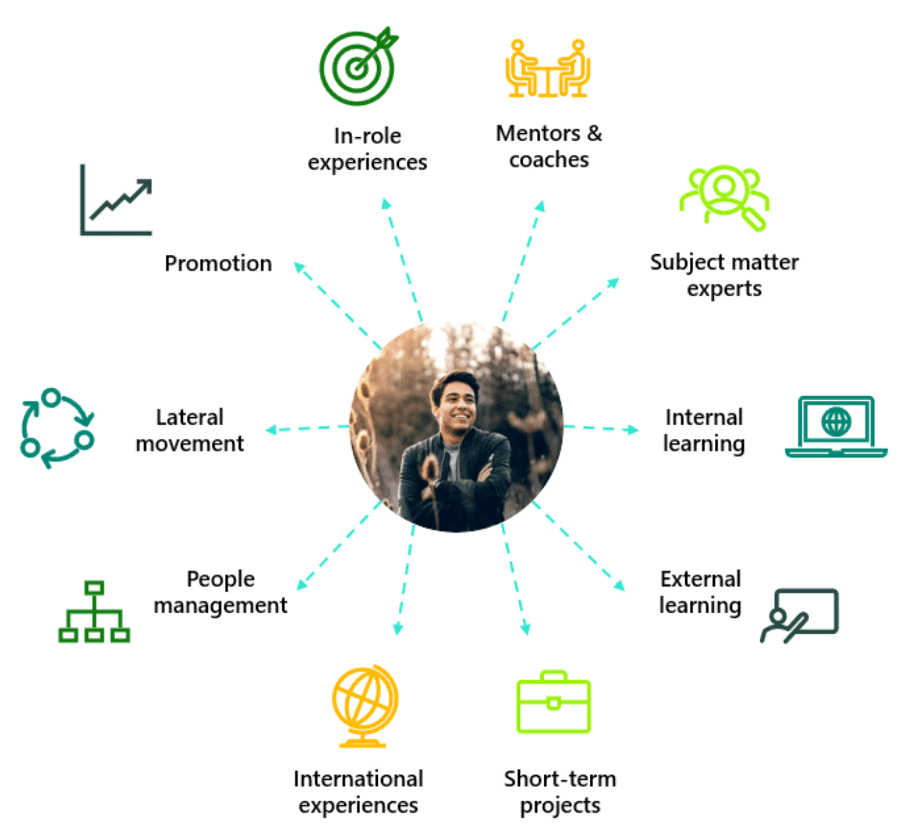
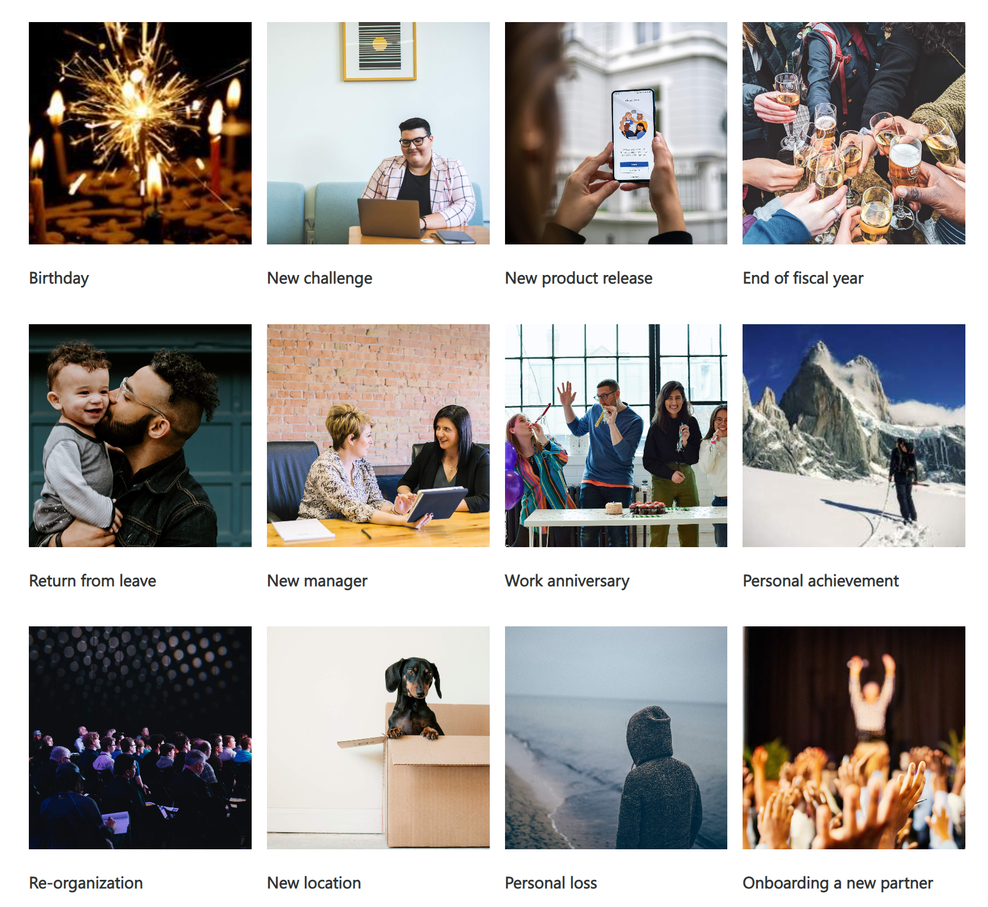
Discuss these career development options with your manager
Career development solutions
Broad spectrum of options
Optimizing career check-in
Timely * Meaningful * Energizing

Slide 8
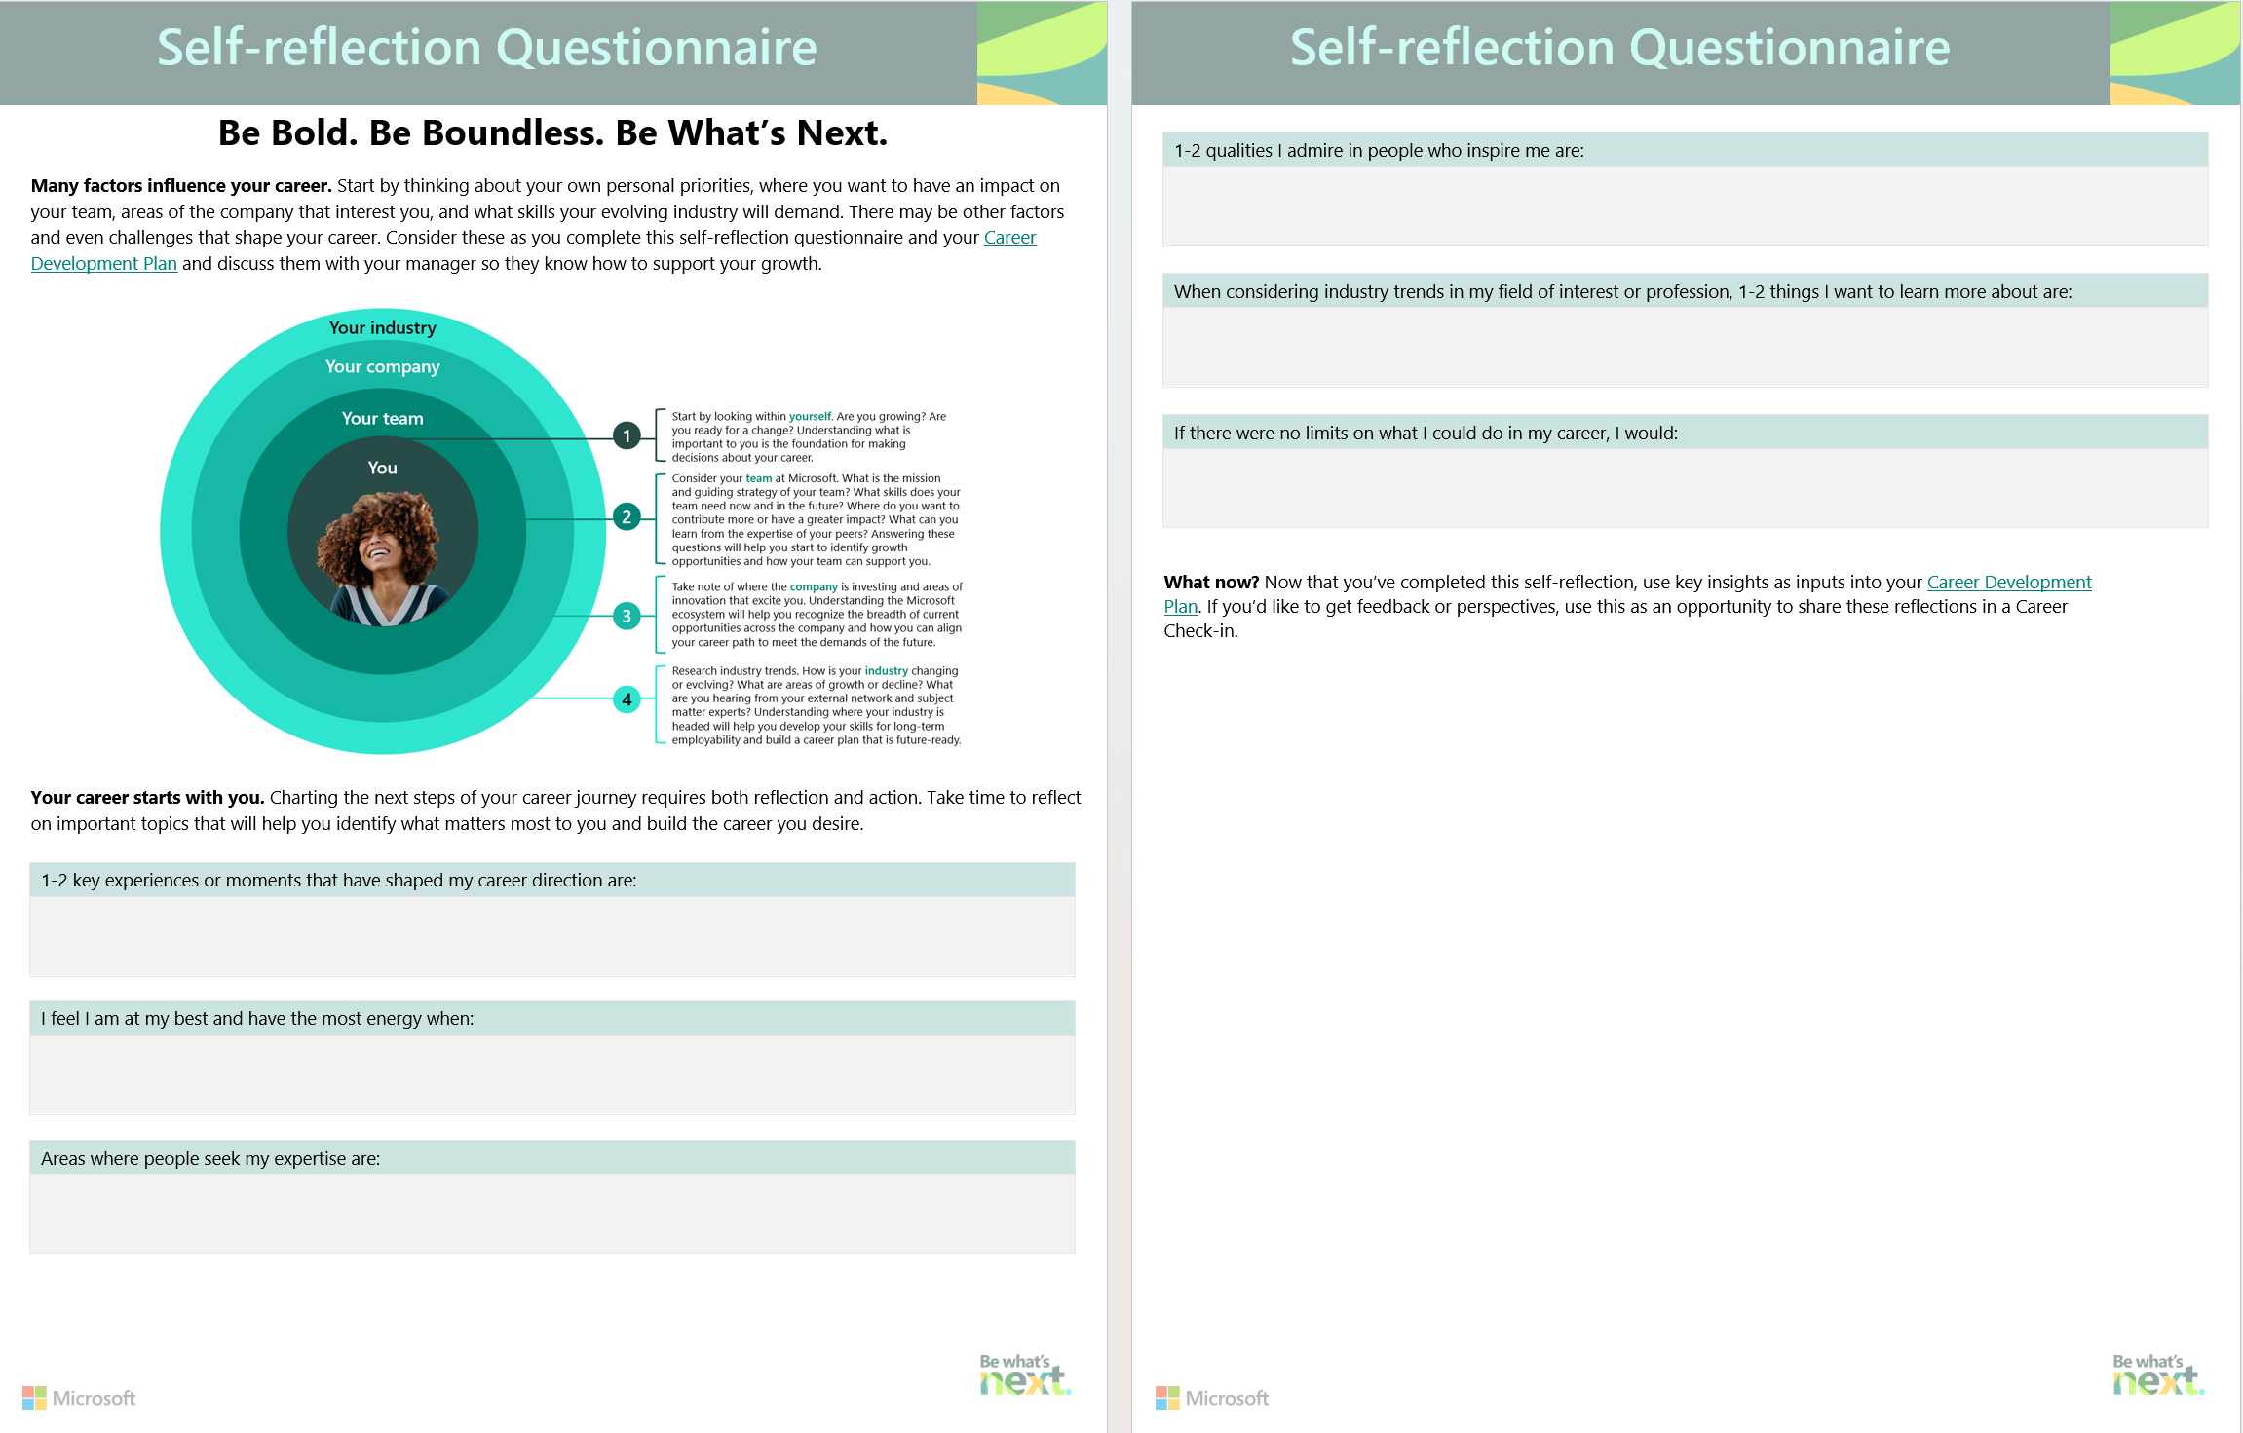
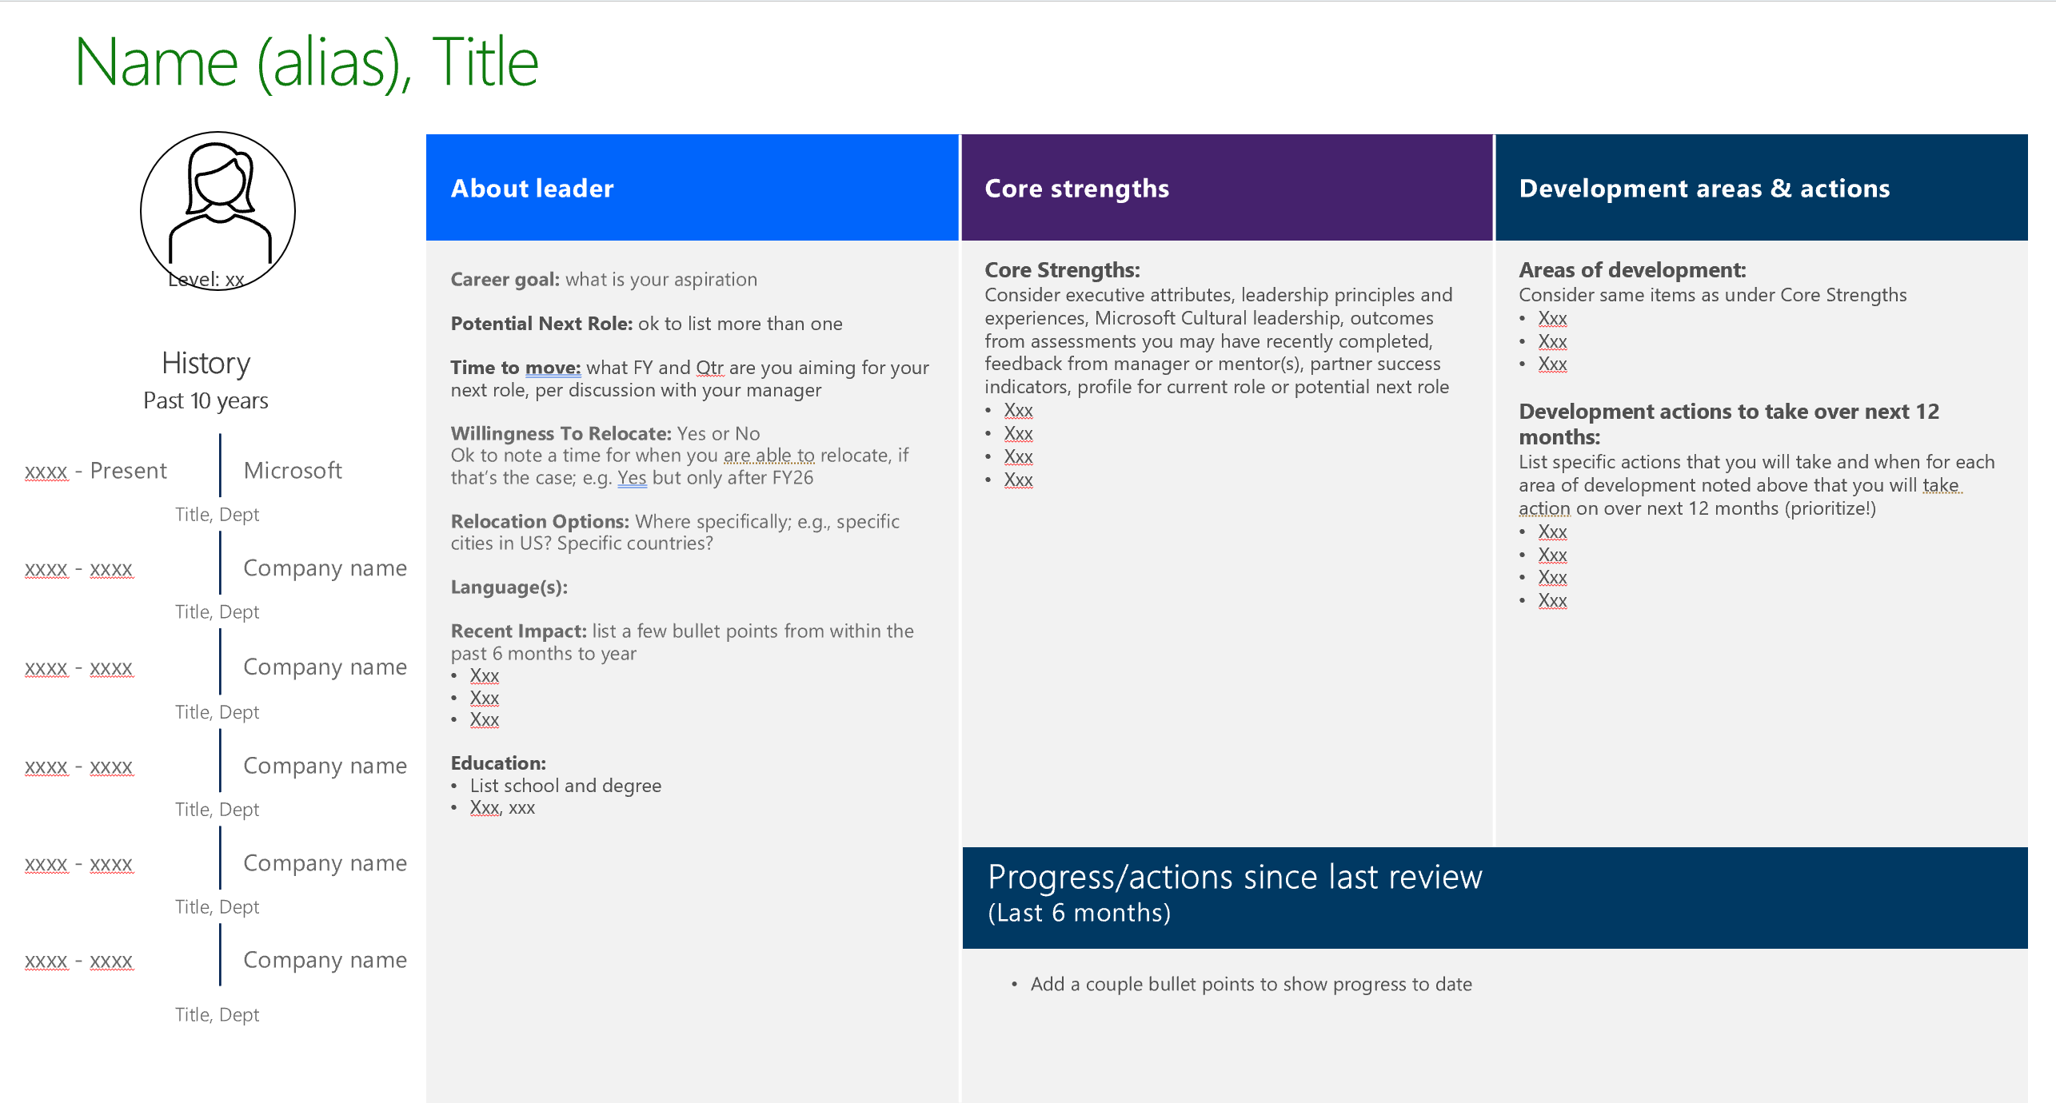
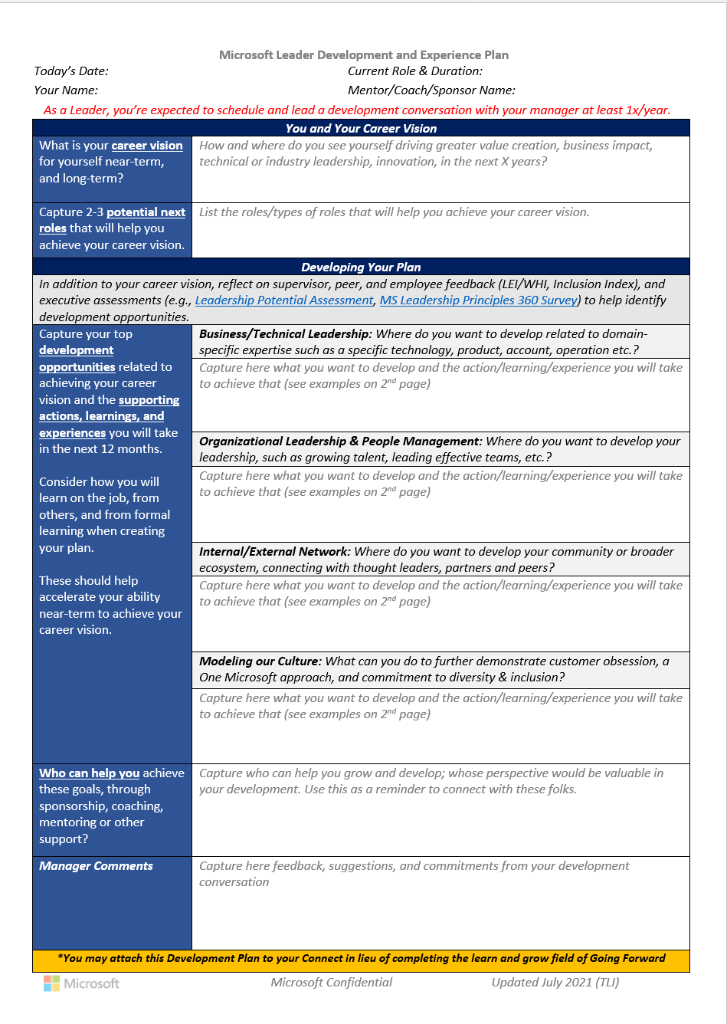
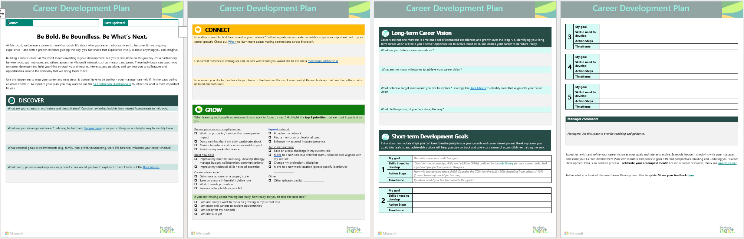

Career Development Plans & Talent Profiles
Self Reflection Resources – optional (leverage for support)
Great questions to ask yourself before you complete your Talent Profile, particularly if you are new to Microsoft, early in career, or never created a development plan.
Talent Profile - mandatory
A one-page self-marketing tool you can share with leaders when interested in a role, seeking a mentor. HR uses this format to share info about talent.
Leader Development & Experience Plan for L68+ - mandatory
A one-page plan shared with Deb, Judson, HR and, in some instances, Microsoft SLT.
https://aka.ms/careercheckinsselfreflection
+
Review with your manager, mentor(s), HRBP, Talent Manager
https://aka.ms/careerdevelopmentplan
Microsoft L68+ Development Plan.docx

